Slide 2
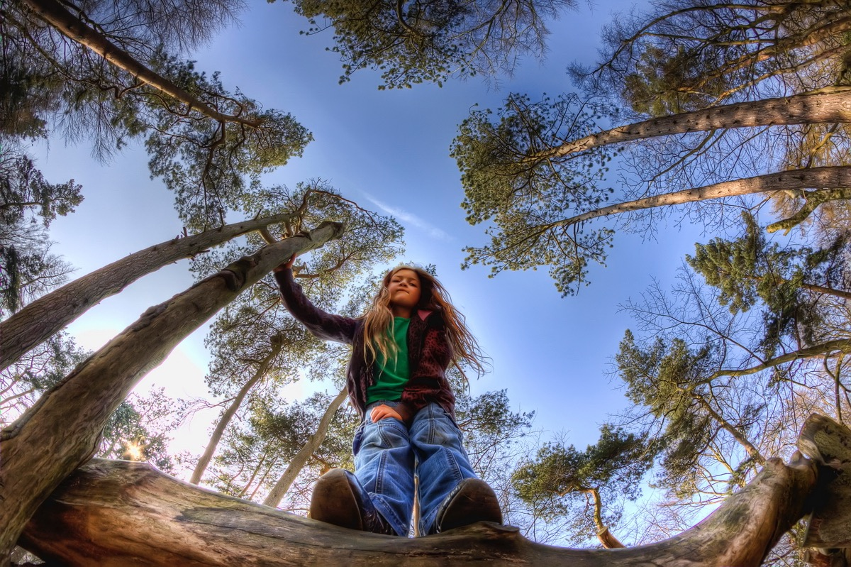
Loved Called Gifted

Slide 3
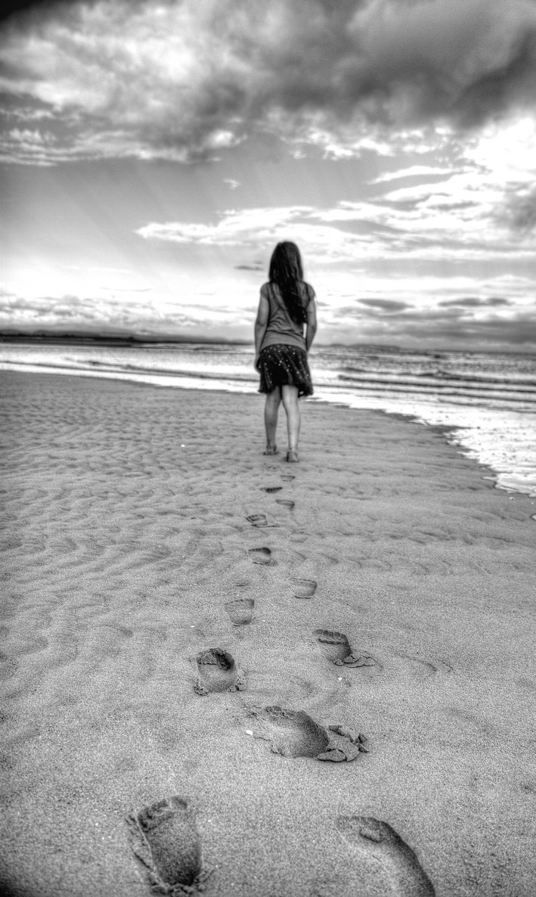
Our aims:
To discover anew that we are deeply loved
To explore our gifts and calling
To find out what’s getting in our way
To make plans to step into what God has called us to do.

Slide 4
To explore further
Easy to read, accessible, personable, not intimidating, great quotes, well organised, well explained. Does what it says it does. I wish I had had this book when I first became a Christian. It would have made a big difference to my journey.’
Rev John Alessi, Vicar of St Pauls, Longton, Stoke-on-Trent
Can I have some more copies? I want to give them to all my friends.’
Caroline Markham, Worship Leader

Slide 5
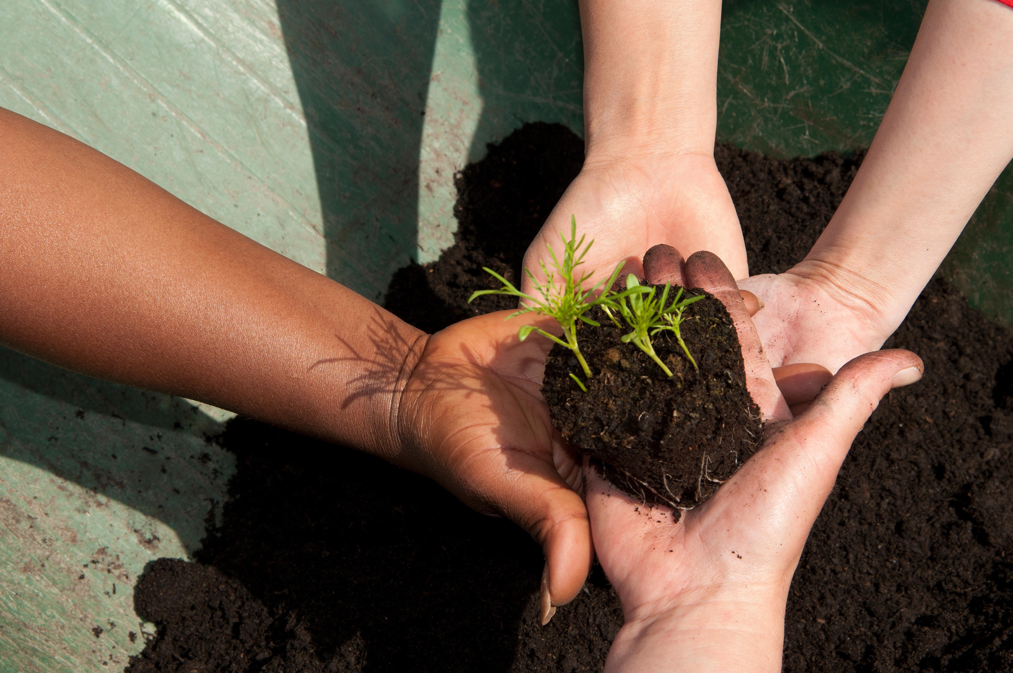
Ground rules

Slide 6
Introvert or extravert?

Slide 7
Loved
I am unique, precious and deeply loved by God
Called
I am called to do something interesting and exciting
Gifted
I am gifted and talented. I can do the things God is calling me to do

Slide 8
You are loved!

Slide 9
What about you?
Think about these two questions. Place a cross on the line in the place that best reflects how you feel.
How easy do you find it to believe that each human being is precious and deeply loved by God?
_________________________________________________________________________________________
Impossible Very easy
How easy do you find it to believe that you, personally, are precious and deeply loved by God?
_________________________________________________________________________________________
Impossible Very easy

Slide 10
What about you?
Think about these two questions. Place a cross on the line in the place that best reflects how you feel.
How easy do you find it to believe that each human being is precious and deeply loved by God?
_________________________________________________________________________________________
Impossible Very easy
How easy do you find it to believe that you, personally, are precious and deeply loved by God?
_________________________________________________________________________________________
Impossible Very easy

Slide 11
Your inner voice
If the voice you use to talk to yourself in your head was a person, what would they look like?

Slide 12
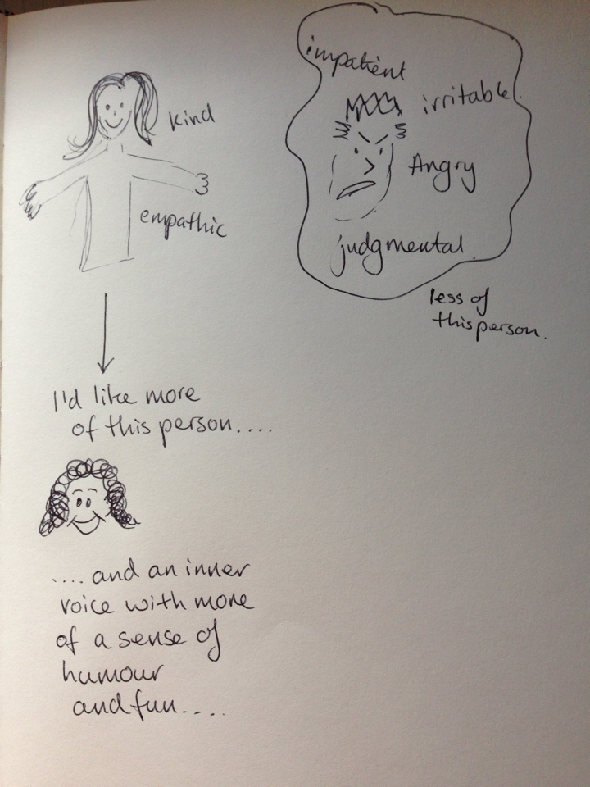
Your inner voice
Draw the person who speaks in your head. There might be more than one.
Then draw the person or people you would like instead.

Slide 13
The cycle of doing
Feelings of worth are fleeting. Am I good enough?
I am what I achieve
I succeed!
I feel great!
I want to feel I am worth something
I strive to achieve or for possessions.
Oops!
I worry that I’m not worth anything
Doing nothing makes me feel useless and worthless
I don’t see the point of trying to achieve anything.

Slide 14
The cycle of being
I do because I can!
I know that:
I am valuable
I am precious
I am loved by God
I feed my soul / rest in God’s loving presence and I am restored
I don’t have to do anything. Simply being me is enough.
This gives me energy and joy.
Sometimes I worry that I’m not good enough. Maybe I’m not OK after all.
I worry about what others think of me.
When I work hard I get tired
I do things because I can.
They are an expression of who I am

Slide 15
What feeds your soul?

Slide 16
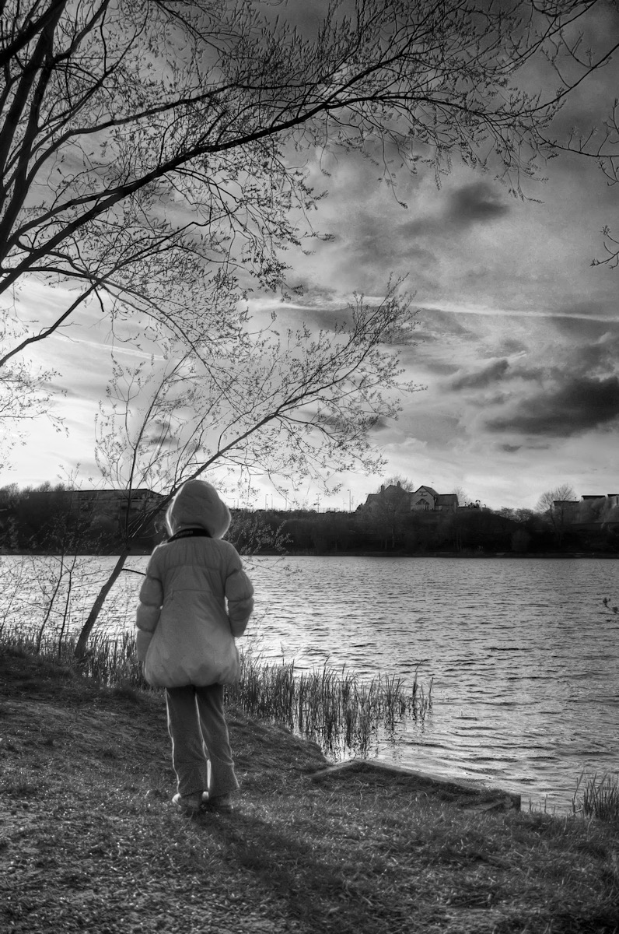
Solitude

Slide 17
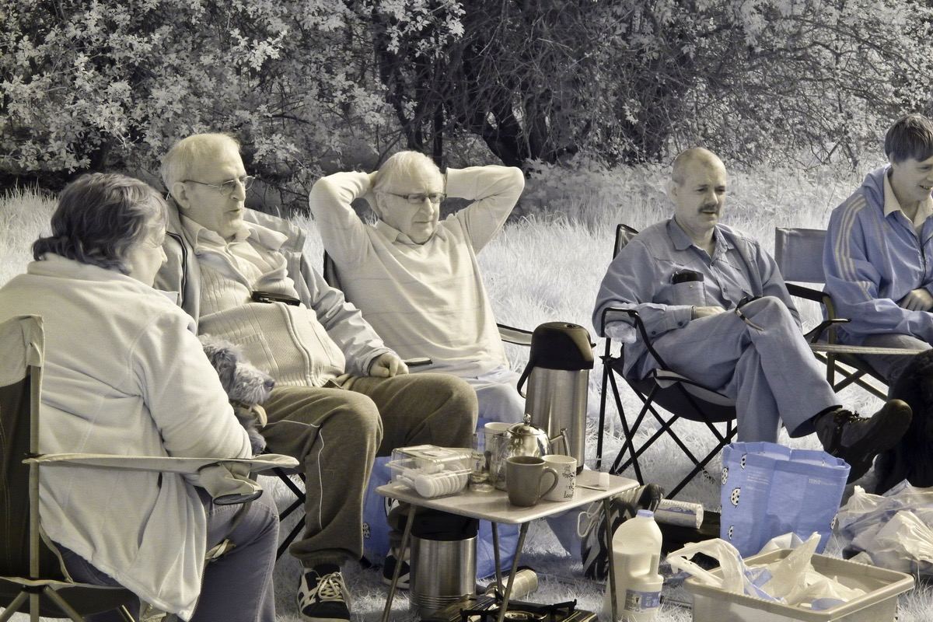
Company

Slide 18
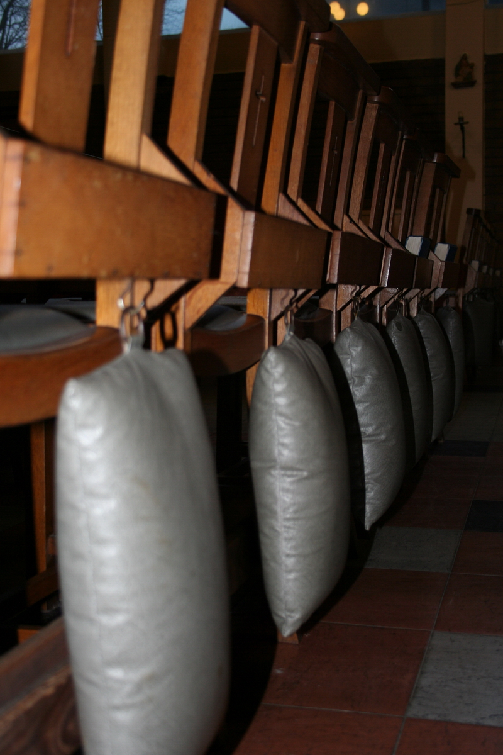
Discipline
Routine, structure, engaging in the same spiritual practices at the same time each day.

Slide 19
Spontaneity

Slide 20
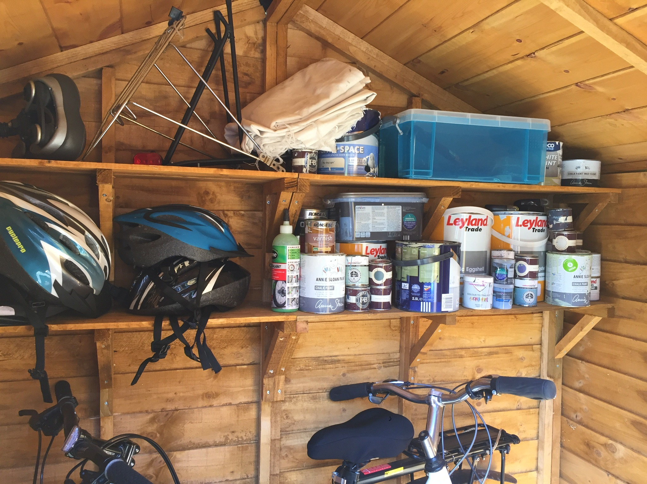
Down to earth
Practical. Facts. Based in real life.

Slide 21
Wonder
Things that spark your imagination.
New ideas.
Possibilities.

Slide 22
Stormy weather
You find you grow most when life is hardest.
God seems closest when you’re up against it.
If things aren’t difficult, you look for a challenge.

Slide 23
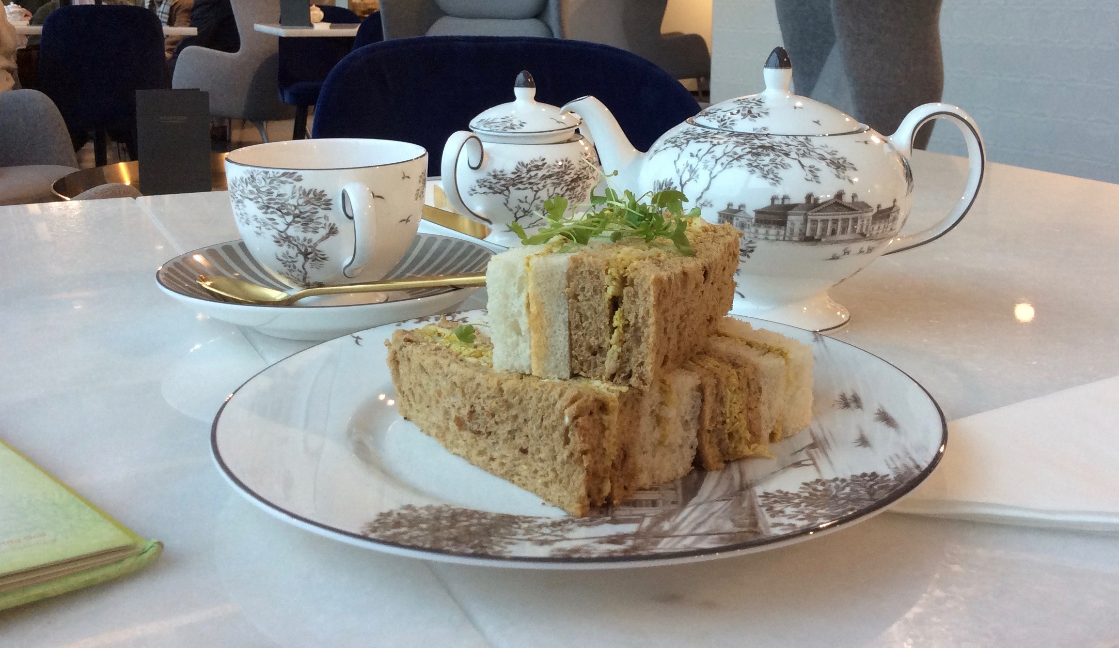
Blue skies
You feel more spiritually connected when life is going well.
Comfort helps.

Slide 24
Beauty
Arts, creativity, excellent music, beautiful things

Slide 25
Nature

Slide 26
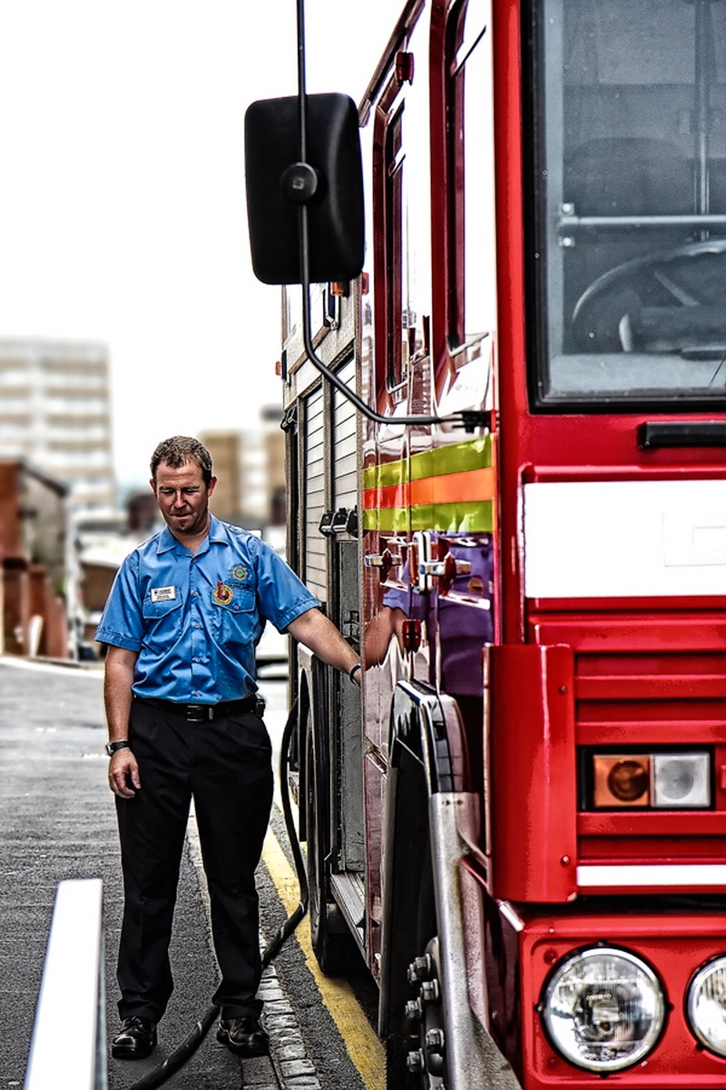
Service
Helping others in practical ways, revives your soul

Slide 27
Justice
You feel closer to God when you are fighting for a cause

Slide 28
Mind
Thinking and learning makes you feel alive

Slide 29
Tradition
Ritual, ceremony, ancient traditions

Slide 30
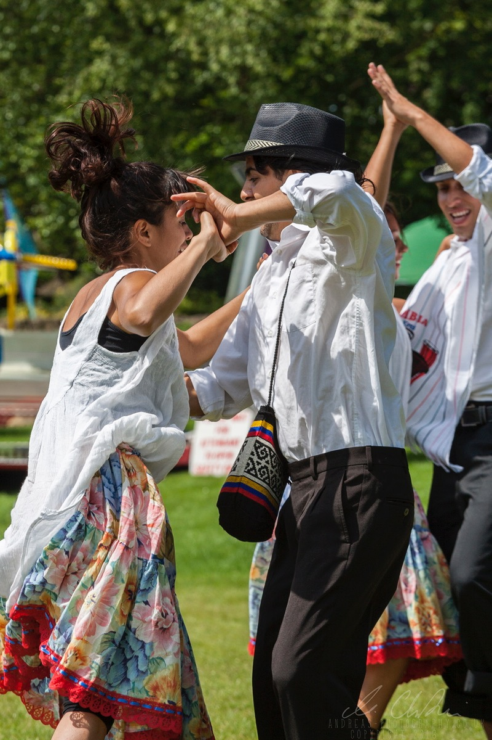
Song and dance

Slide 31
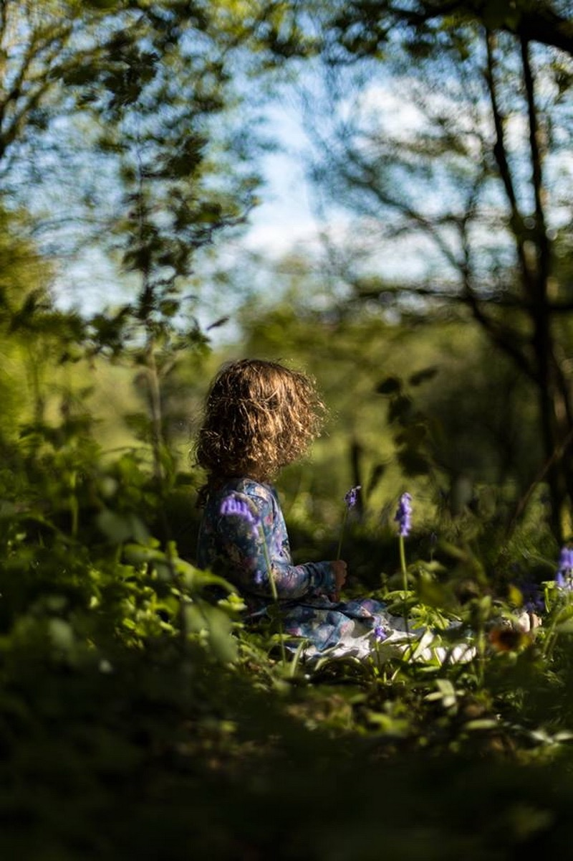
Heart
Sensing God’s love and expressing your love for God.
Experiencing emotional connection with your inner self and the universe we are part of.

Slide 32
Charismatic
Prophetic words and images, direct experiences of the divine, worship where you sense the presence of God

Slide 33
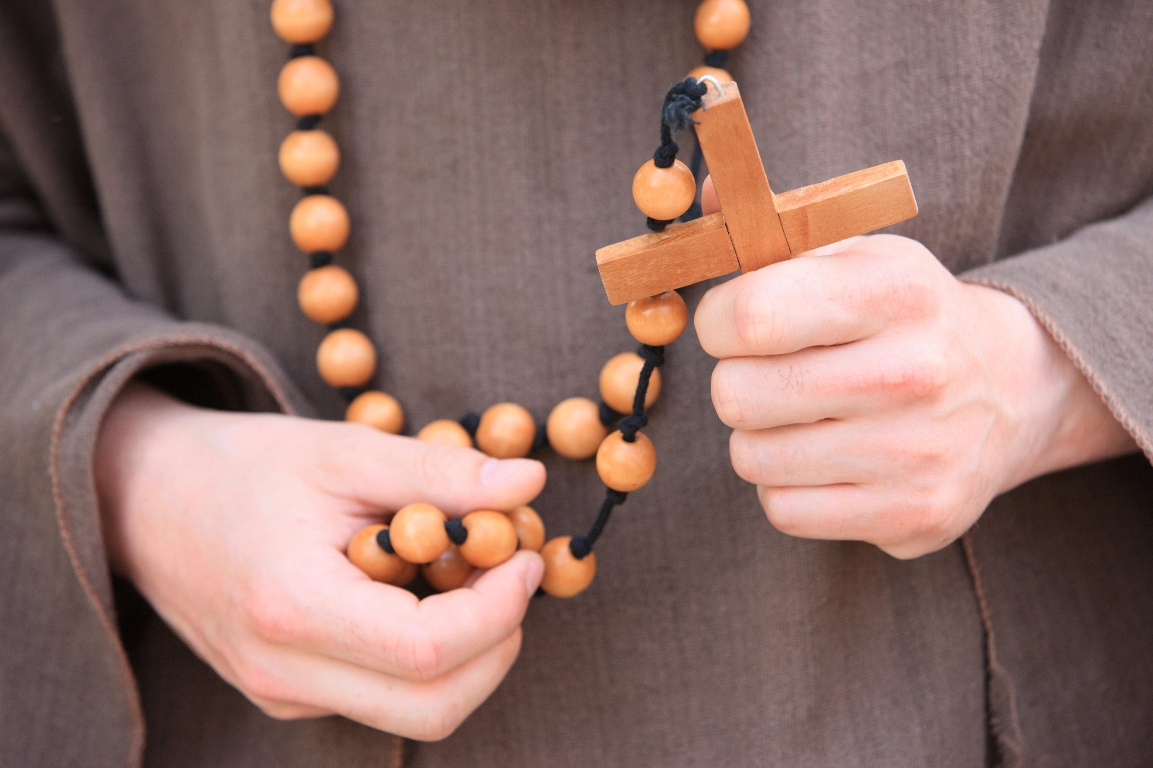
Monastic
Simplicity, poverty, fasting, silence

Slide 34
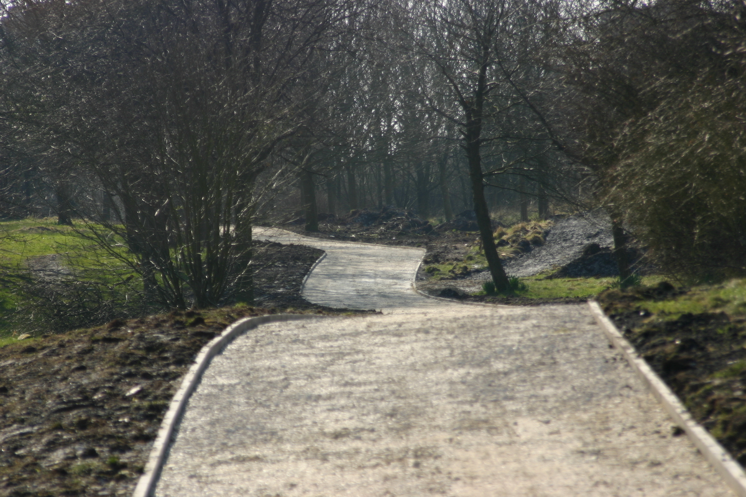
Your life journey

Slide 35
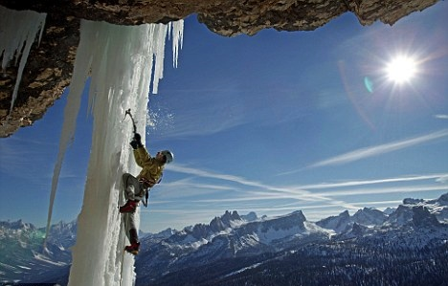
Calling myths
Whatever God wants me to do will be terrifying

Slide 36
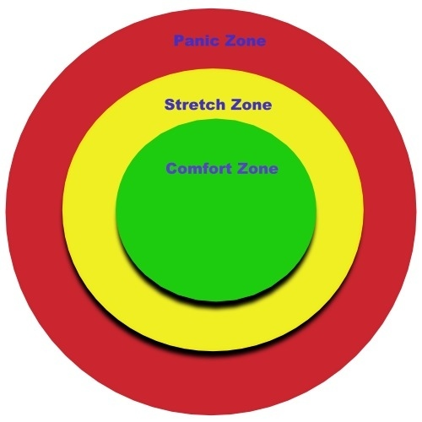
Stretched, but not panicked

Slide 37
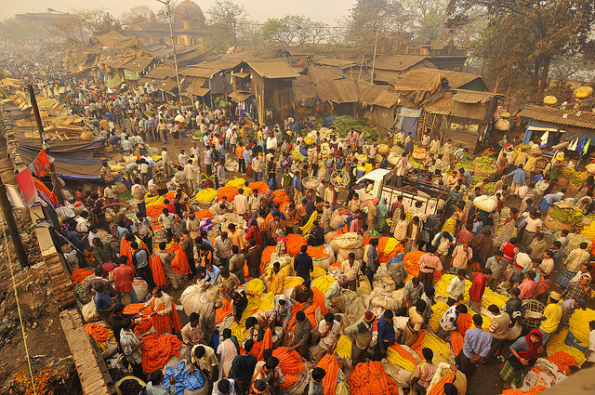
Don’t tell God you don’t like hot weather or curry or He’ll send you to India...

Slide 38
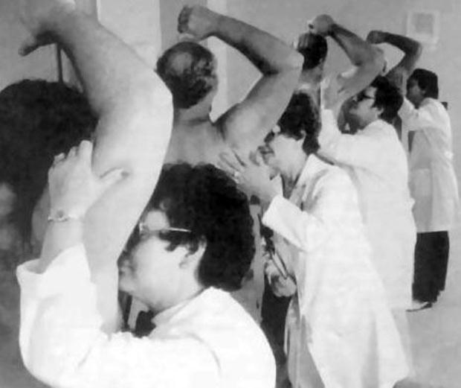
God will have me doing all sorts of things I don’t like

Slide 39
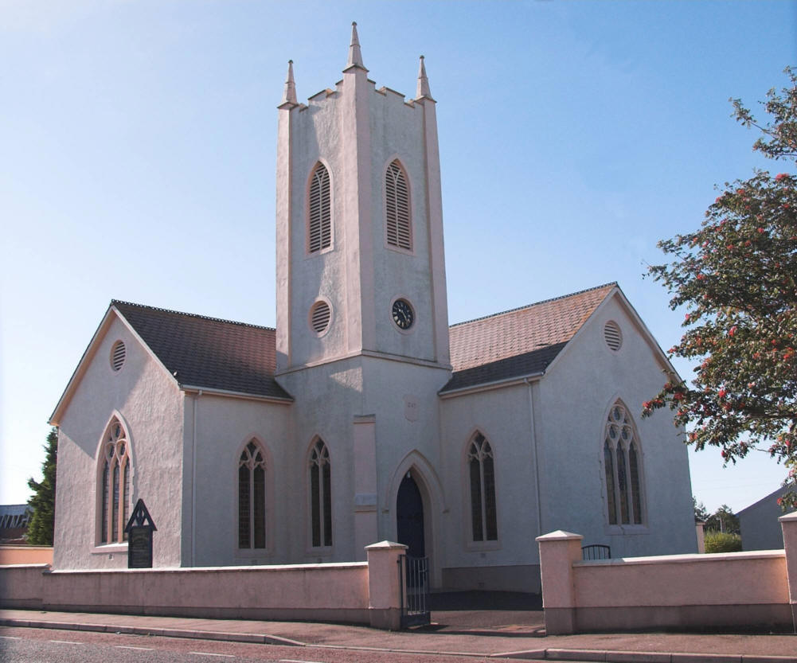
Only the stuff you do in church really counts

Slide 40
It doesn’t count if it doesn’t fit with my church’s vision

Slide 41
We have no choice in God’s plan

Slide 42
If you take a wrong turn, you’ll miss out on God’s best for you

Slide 43
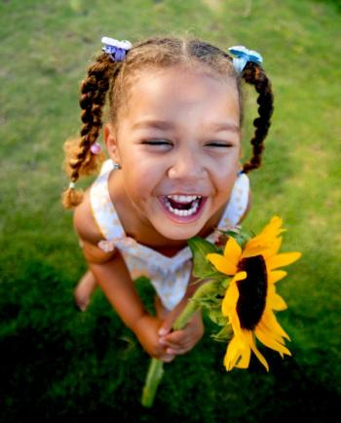
It can’t possibly be God’s calling if you’re having fun

Slide 44
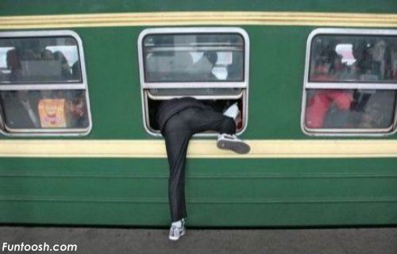
It’s too late. I’ve missed God’s call. He won’t use me now.

Slide 45
The need is the call

Slide 46
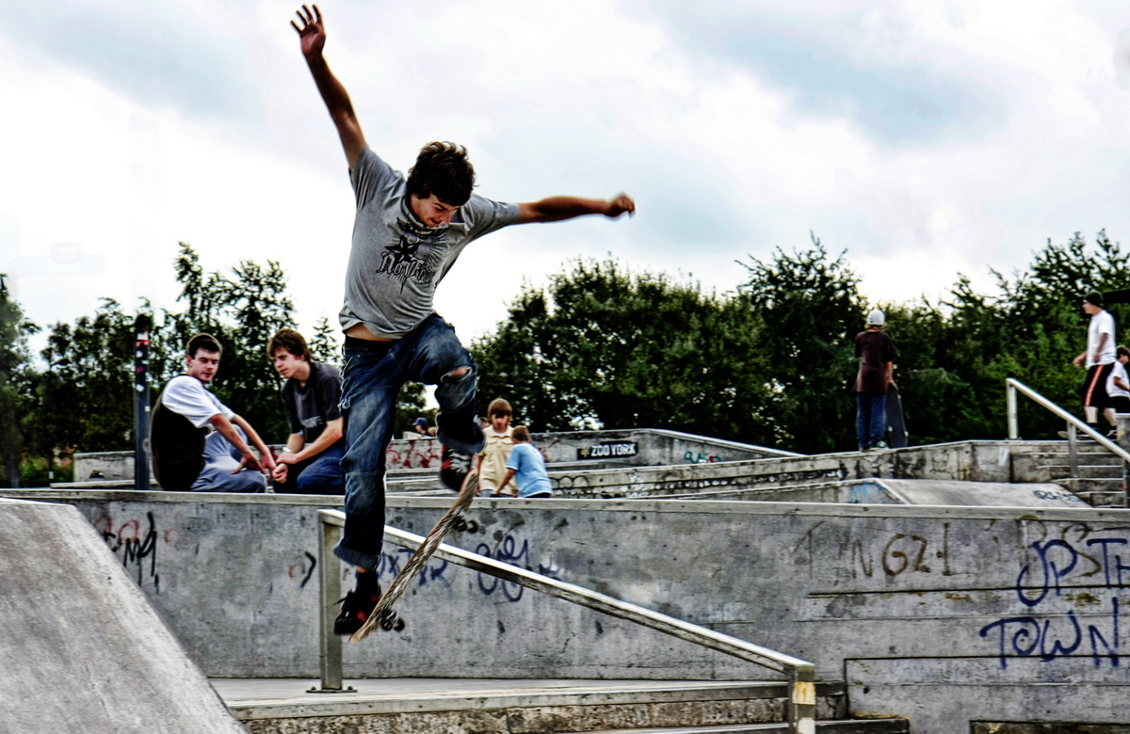
What gives you life?

Slide 47
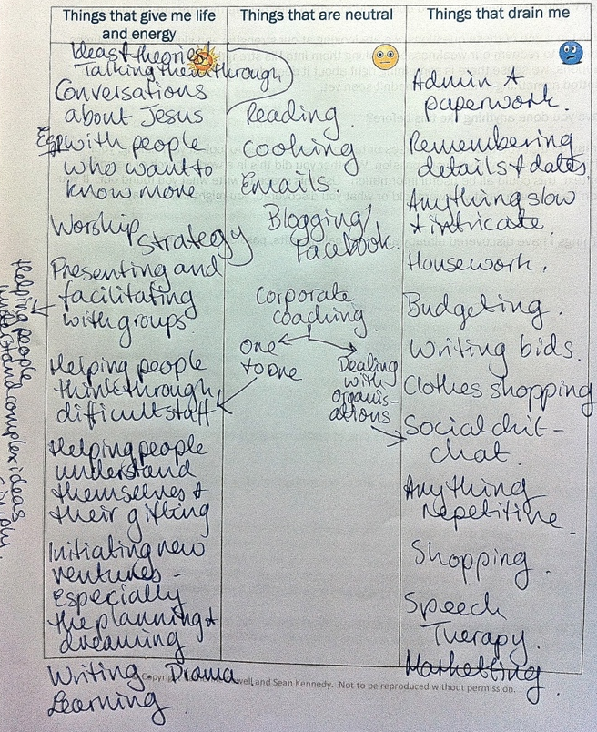
What gives you life?
Think about the things that you do regularly. Do they leave you feeling drained, or energised?
When you’ve made your list, have a look and see what it tells you about yourself.

Slide 48
Just imagine

Slide 49
Your message to the world
It can be about whatever you want

Slide 50
What makes you angry?

Slide 51
What do you love?

Slide 52
What has God already said to you?

Slide 53
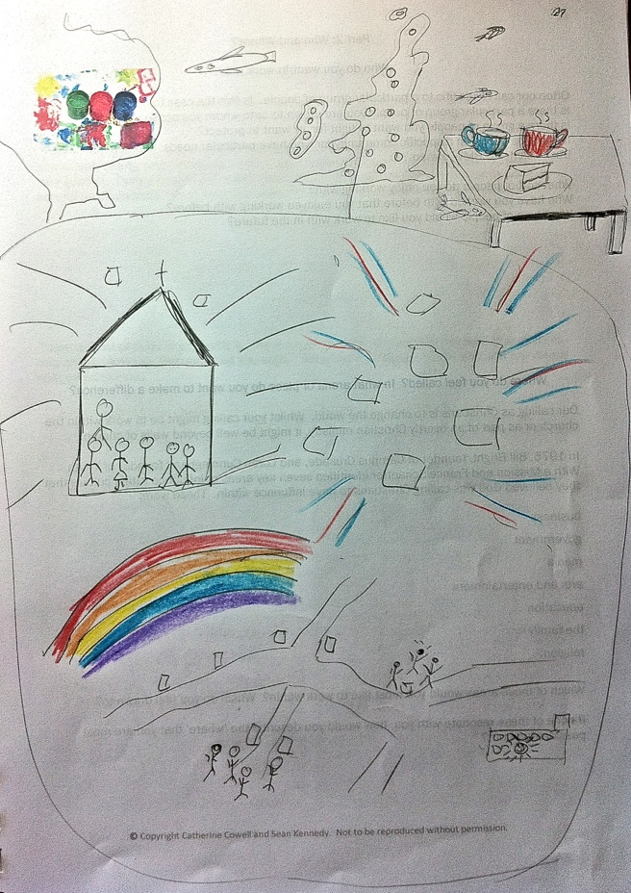
Draw your dreams
What would you do if you weren’t afraid?
What if you knew you couldn’t fail?
What if you knew you had the support of your friends and family?

Slide 54
Gifts and Abilities

Slide 55
What kinds of intelligence do you have?
“Everybody is a genius. But if you judge a fish by its ability to climb a tree it will live its whole life believing it is stupid”
Albert Einstein

Slide 56
Bodily / kinaesthetic

Slide 57
Musical

Slide 58
Spatial

Slide 59
Linguistic

Slide 60
Logical / mathematical

Slide 61
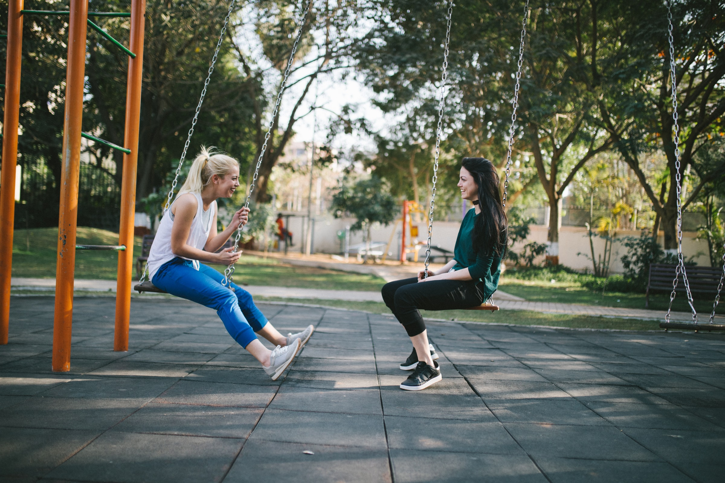
Interpersonal

Slide 62
Intrapersonal

Slide 63
Naturalistic

Slide 64
Existential

Slide 65
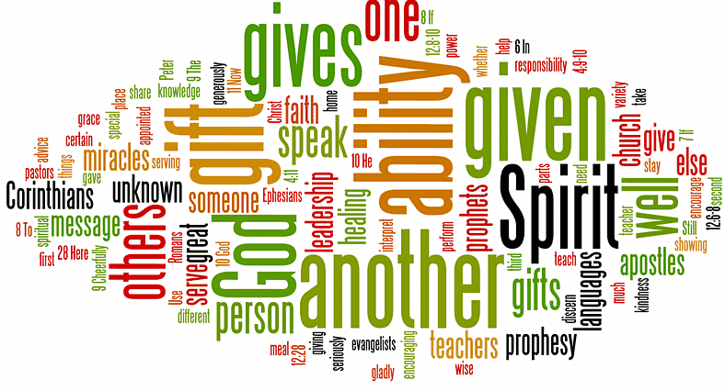
Spiritual Gifts

Slide 66
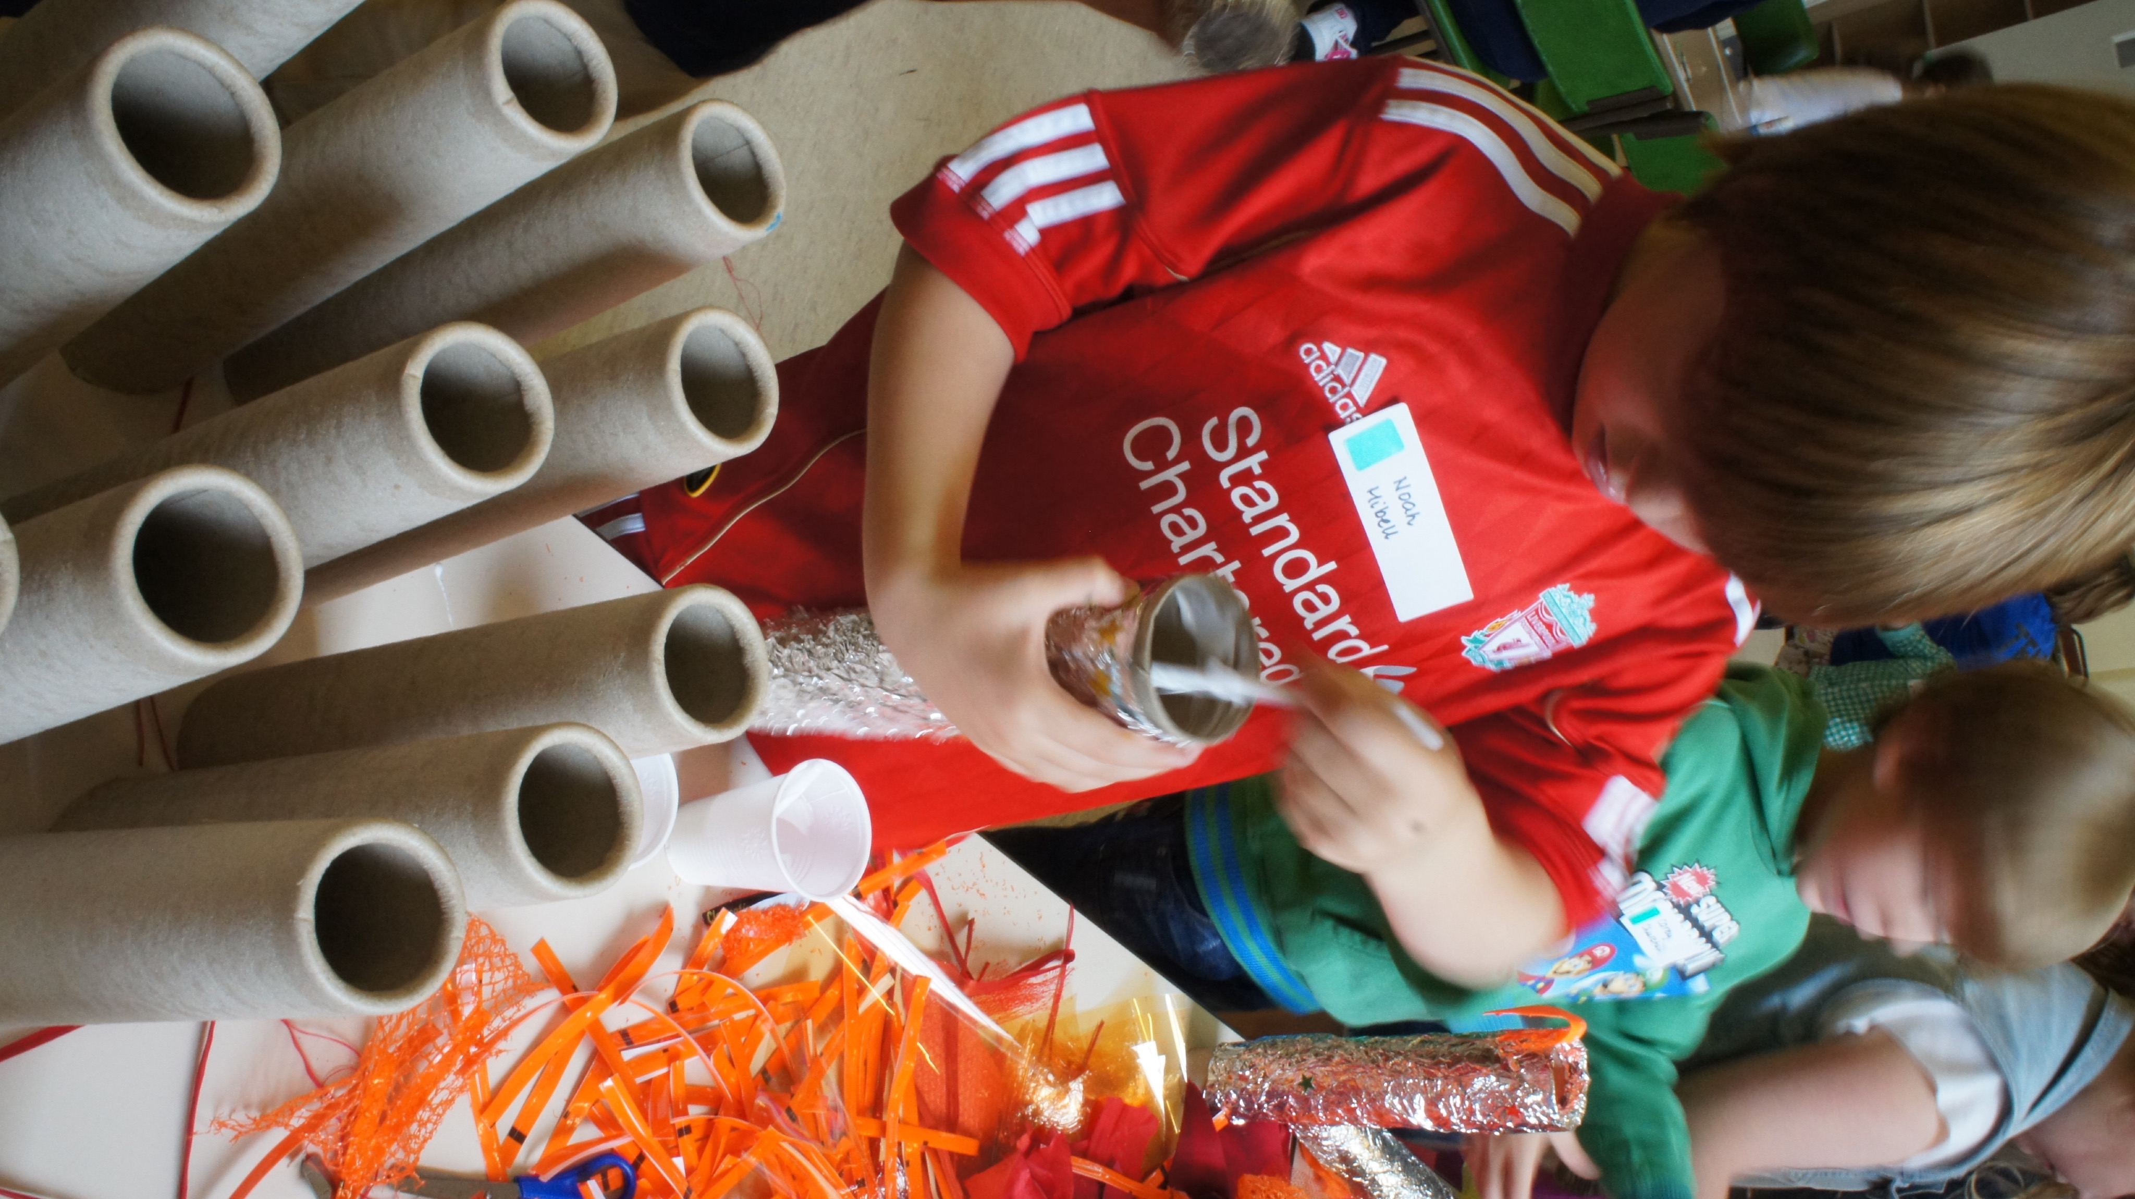
Putting it all together

Slide 67
What gets in our way?

Slide 68
What gets in our way?
External interference
Circumstances, time, money, health…
Internal interference
The things going on inside of us that hold us back.
Performance = Potential - Interference

Slide 69
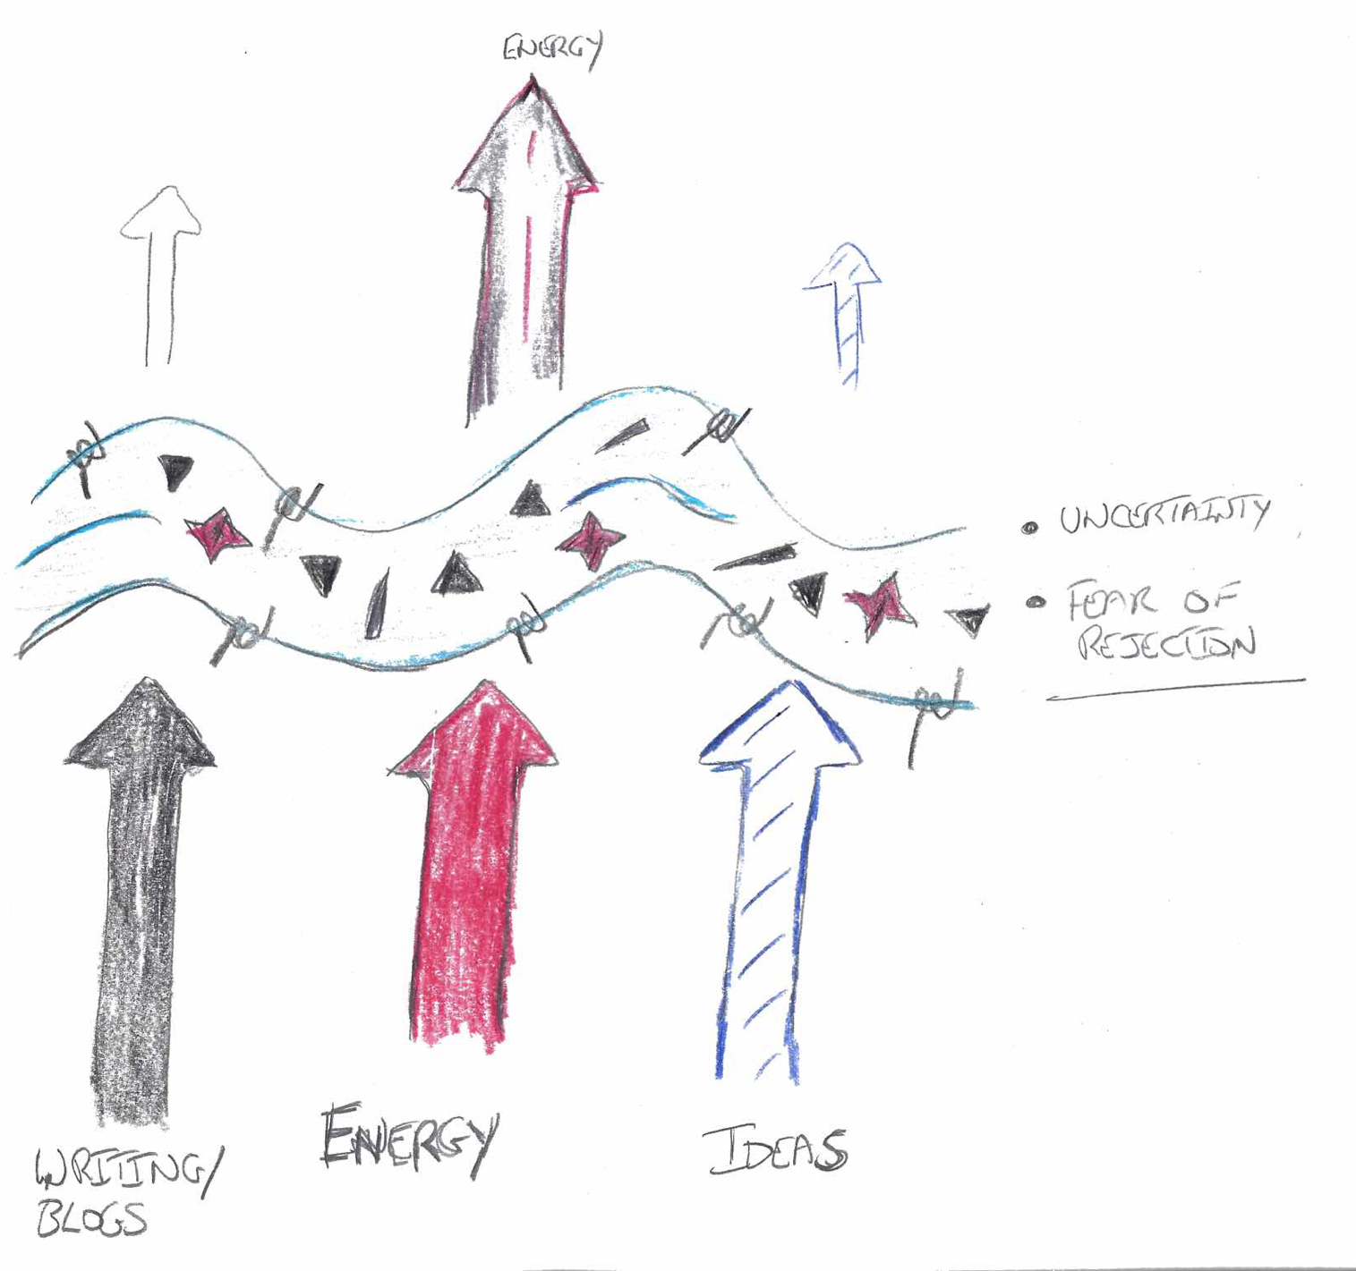
Draw what’s stopping you

Slide 70
The rucksack

Slide 71
The miracle
While you are asleep tonight a miracle occurs. All the
difficult things that have been getting in your way are
sorted out. What would be different?

Slide 72
Reflection
What have you learnt about valuing and taking care of yourself?
What have you discovered about your life purpose and your next steps in life?

Slide 73
Partners, supporters and networks

Slide 74
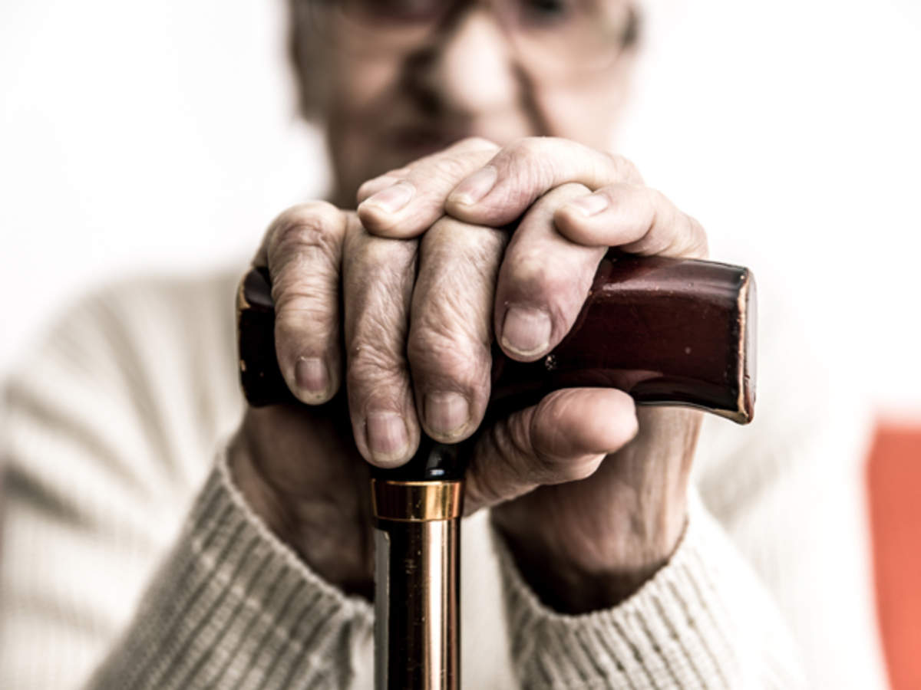
Embracing our humanity

Slide 75
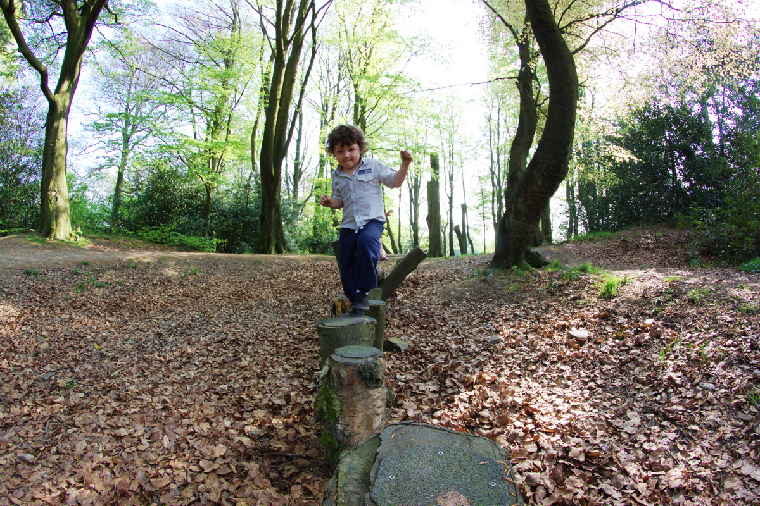
Planning your next steps

Slide 76
Exploring further…
If you would like to explore your own journey further, or learn about leading others in a way that helps them with their journey, you might be interested in these books by the authors of the course:
You can find the Loved, Called, Gifted podcast and further information, resources and services at:
lovedcalledgifted.com

Slide 77
Images in this presentation have been purchased or used with permission and are not to be used for other purposes

